Slide 1
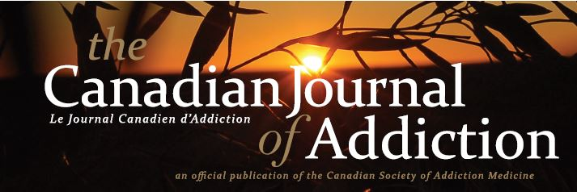
“Editorial Roles & Governance” Session ISAJE 2020
Nady el-Guebaly C.M.
MD, DPsych, DPH, FRCPC, DABAM, CISAM,
DLFAPA, EFACP, DFASAM, DFCPA
Professor Emeritus of Psychiatry, University of Calgary
Editor in Chief, Canadian Journal of Addiction
Disclosures: None

Slide 2
Canadian Journal of Addiction
Le Journal Canadien d’Addiction
Phase I
Objective: a national voice for our field (Health System, Social Network, Policies…)
Ownership: Canadian Society of Addiction Medicine; 500 members dues
Scope: From Physicians to Multidisciplinary audience
Boards: Society’s experienced volunteers
National & International reviewers lists
Joining ISAJE: a “School for Editors”
A long journey: 2014 - ?
A Publisher’s guidance: 2017

Slide 3
Top 20 Addiction Publications – Google Scholar – 2019
Publication | Impact Factor | Issues/yr | Founded
Addiction | 6.343 | 12 | 1884
International Journal of Drug Policy | 4.444 | 12 | 1987
Addiction Biology | 4.121 | 6 | 1996
Nicotine & Tobacco Research | 4.079 | 12 | 1999
Drug and Alcohol Dependence | 3.951 | 12 | 1975
Alcohol Research | 3.79 | 3 | 1994
Addictive Behaviors | 3.645 | 12 | 1975
Alcoholism-Clinical and Experimental Research | 3.235 | 12 | 1977
Journal of Substance Abuse Treatment | 3.083 | 8 | 1984
Journal of Addiction Medicine | 3.014 | 6 | 2007
The American Journal of Drug and Alcohol Abuse | 2.925 | 6 | 1974
Psychology of Addictive Behaviors | 2.78 | 8 | 1987
Journal of Behavioral Addictions | 2.68 | 4 | 2012
Substance Abuse | 2.652 | 4 | 1984
Drug and Alcohol Review | 2.472 | 7 | 1982
Journal of Studies on Alcohol and Drugs | 2.448 | 6 | 1940
The American Journal on Addictions | 2.371 | 6 | 1992
Alcohol and Alcoholism | 2.078 | 6 | 1963
International Journal of Mental Health and Addiction | 1.648 | 6 | 2003
Substance Use & Misuse | 1.497 | 14 | 1966*

Slide 4
Phase II’s Challenges
Number & quality of submissions
Acceptance rate
Reviewer recruitment & sustenance:
Editorial Board listing per Issue
Publishing reviewer names annually/per publication?
Educational credits
Publons
Impact Factor: The “Brass Ring” & Catch 22
International perspectives
Others?
} Submission α Acceptance rates

