Slide 1
Update on Coalition for Diversity and Inclusion in Scholarly Communications

Slide 2
Coalition for Diversity and Inclusion in Scholarly Communications
founded by 10 trade and professional associations working in scholarly communications.
formed to discuss issues of diversity and inclusion within scholarly publishing, including gender equality and ethnic diversity in workforce
“Publishing is truly a global enterprise yet that diversity is not reflected in our collective demographics.”
Areas of work include providing training resources, best practices, toolkits, and establishing outreach programs, curricula, events, and publications.
Our goal is to promote involvement, innovation, and expanded access to leadership opportunities that maximize engagement across identity groups and professional levels.

Slide 3
Justification/rationale
Research suggests that diverse teams working together and capitalizing on innovative ideas and distinct perspectives outperform homogeneous teams.
Professionals from diverse backgrounds and life experiences bring different perspectives, creativity, and individual enterprise to address the issues facing our industry.
Benefits of a diverse scholarly publishing ecosystem include: fostering innovation and problem solving; contributing to robust learning environments, worker satisfaction.
Diverse teams will enable us to better serve the increasingly diverse research and academic communities that are both the creators and consumers of scholarly publications.

Slide 4
Identity groups include
• ability/disability
• age
• ethnicity
• gender and gender identity
• geographic location
• race/color
• sexual orientation
• socio economic background/social class

Slide 5
Joint Statement of Principles
We are committed to:
•eliminating barriers to participation, extending equitable opportunities across all stakeholders, and ensuring that our practices and policies promote equitable treatment and do not allow, condone, or result in discrimination;
•creating and maintaining an environment that respects diverse traditions, heritages, and experiences;
•promoting diversity in all staff, volunteers, and audiences, including full participation in programs, policy formulation, and decision-making;
•raising awareness about career opportunities in our industries to groups who are currently underrepresented in the workforce;
•supporting our members in achieving diversity and inclusion within their organizations.

Slide 6
Adopting Organizations
1. Association of Canadian University Presses – Association des presses universitaires canadiennes (ACUP-APUC)
2. Association of University Presses
3. Association of Learned and Professional Society Publishers
4. Canadian Association of Learned Journals
5. Canadian Science Publishing
6. China Editology Society of Science Periodicals
7. Cinémas
8. Council of Science Editors
9. Council on Undergraduate Research
10. Crossref
11. Directory of Open Access Journals (DOAJ)
12. Duke University Press
13. Editorial Universidad del Rosario
14. Elsevier
15. Emerald Publishing
16. European Association of Science Editors (EASE)
17. Information Power Ltd
18. International Society of Addiction Journal Editors

Slide 7
Possible priority areas for ISAJE
Gender equity in publication hierarchy
North/South, East/West representation
Small vs large journals
Clinical, biological and social balance in research and research methods

Slide 8
Example of an ISAJE initiative: Sex and Gender Issues in Scientific Research
Increasing awareness of the gender bias among authors, reviewers, editors, and editorial board members
Evidence of sex/gender disparities in the power structure of the addiction science infrastructure
Adoption of SAGER guidelines

Slide 9
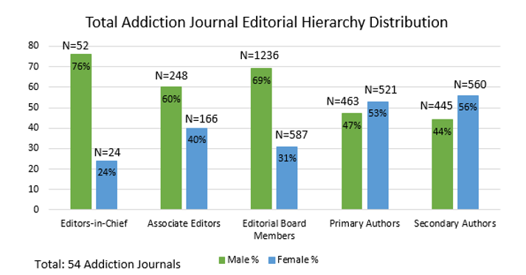

Slide 10
ISAJE Gender Balance Initiative
Conduct an action research project to document and change gender inequities in the journal management workforce, where needed
Raise awareness about the importance of sex/gender in scientific publishing by conducting gender audits of a broad spectrum of scientific journals
Use the data to promote gender mainstreaming and gender balance in editorial boards and editorial offices
Link this initiative to dissemination of SAGER guideline

Slide 11
SAGER Dissemination Pilot Project International Society of Addiction Journal Editors (ISAJE)
Gender audits of 27 member journals and 27 matched nonmember journals
Editors sent emails with results of gender audits, plus ISAJE endorsement, SAGER guideline, request to implement SAGER and gender balance, where appropriate
Editors asked to respond to survey about intensions to adopt SAGER and gender balance recommendations

Slide 12
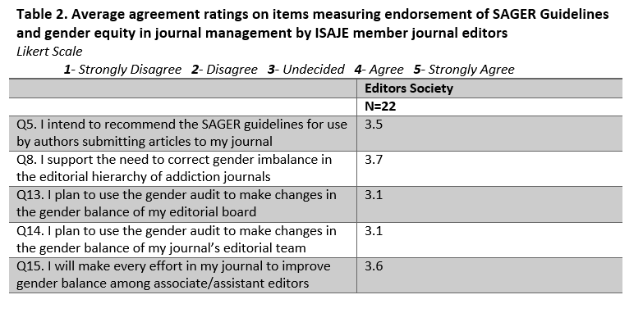
Endorsement of Implementation Statements by Journal Editors who Received SAGER and a Gender Audit

Slide 13
Should ISAJE continue to promote gender audits as a means of awareness-raising? Could this also include ethnic diversity audits?
Send audit results to journal editors (with or without SAGER guideline)
Include toolkit for implementation
Ask for commitment
Track progress in exposed and non-exposed journals

