Slide 1
One journal’s experience with open science initiatives
Katie Witkiewitz, Psychology of Addictive Behaviors
@katiewitkiewitz
katiew@unm.edu
ISAJE 2022, Helsinki, Finland

Slide 2
osf.io
Open resources
Tools/tutorials
Templates
This Photo by Unknown Author is licensed under CC BY-SA

Slide 3
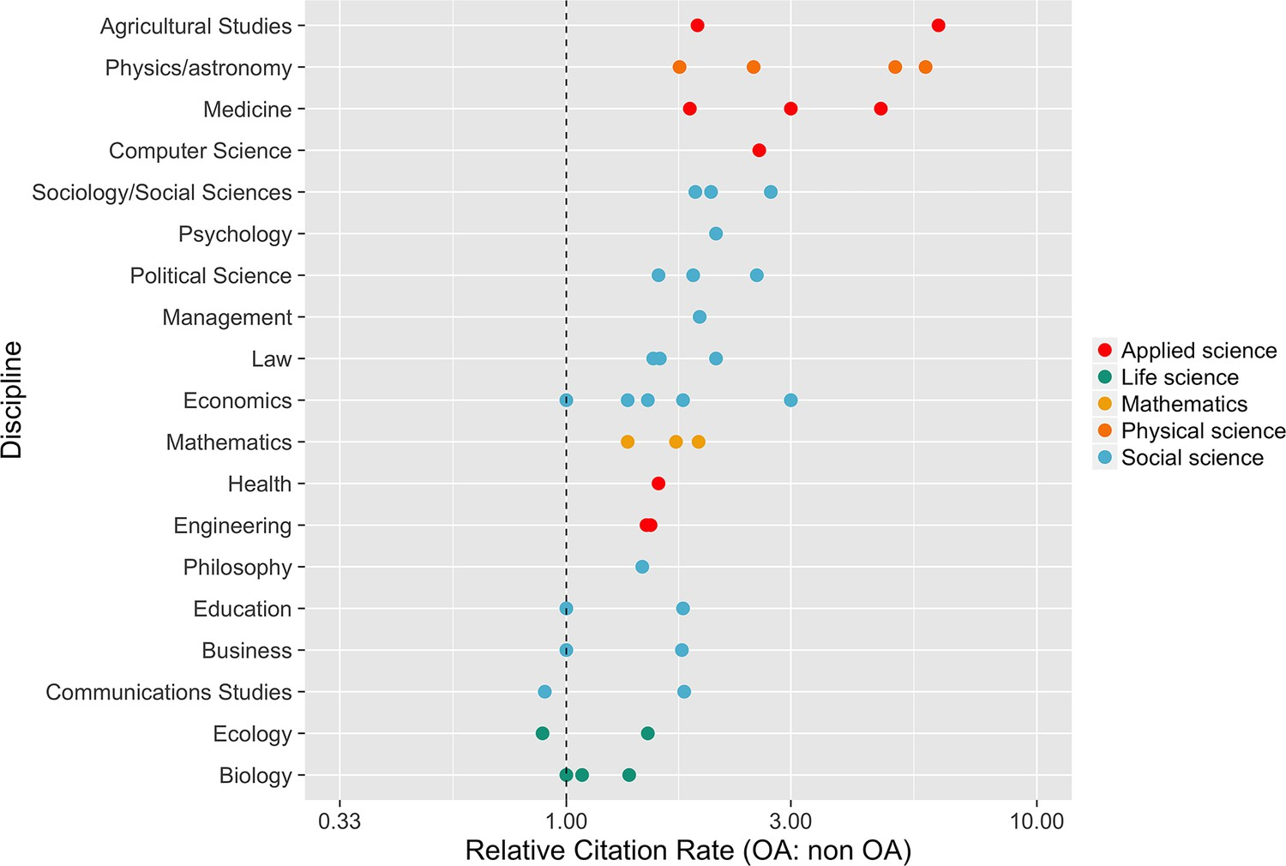
Slide 4 title
Get “badges” for sharing your science
Higher citation rates for open access vs non-open access
Seyhan Can
McKiernan et al 2016
https://elifesciences.org/articles/16800

Slide 4
Slide 5 title
Accelerate discovery and support future scientists
LEAD A PROTEST
Ravi Costa
This Photo by Unknown Author is licensed under CC BY-SA

Slide 5
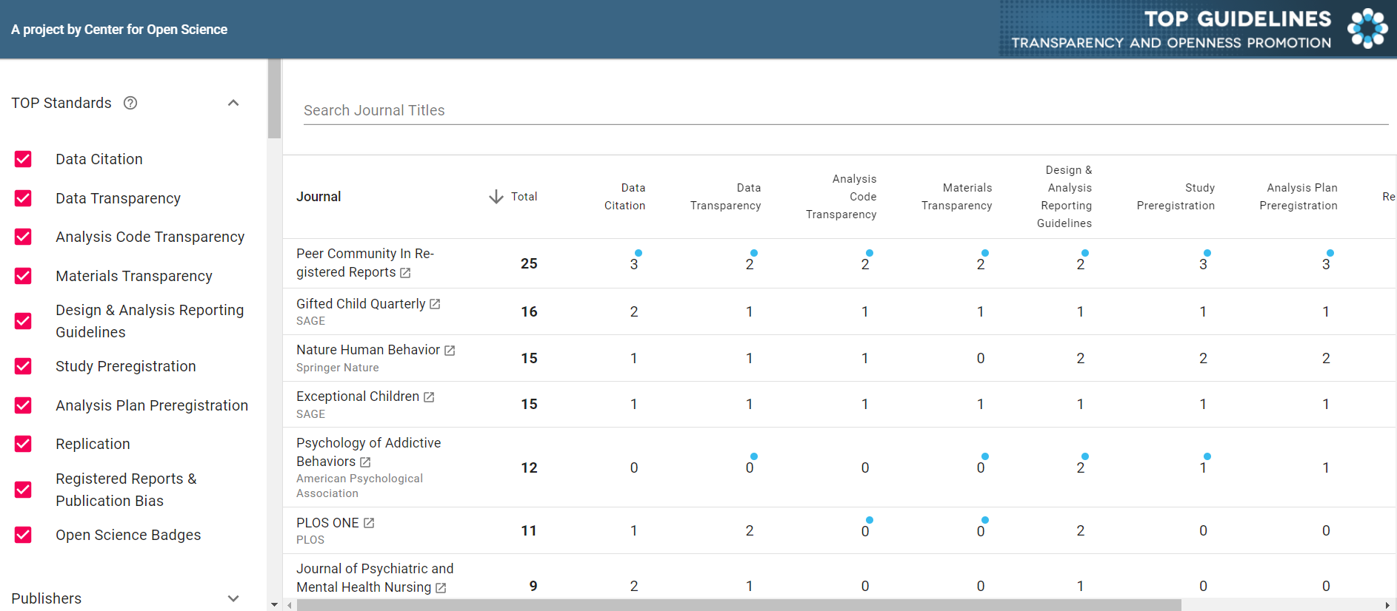
Slide 6 title
Journals are getting on board
https://www.topfactor.org/

Slide 6
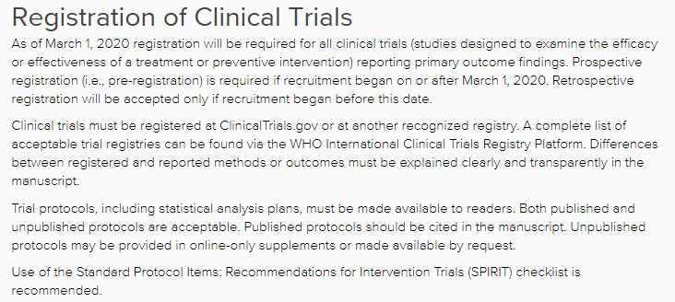
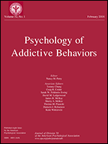
Psychology of Addictive Behaviors
https://www.editorialmanager.com/adb/
Kevin King, PhD, Associate Editor for Open Science

Slide 7
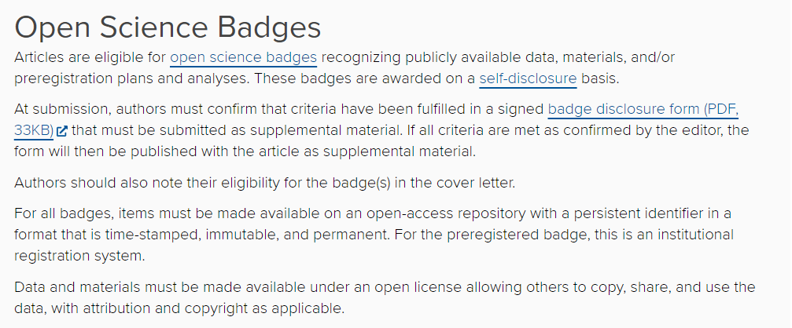
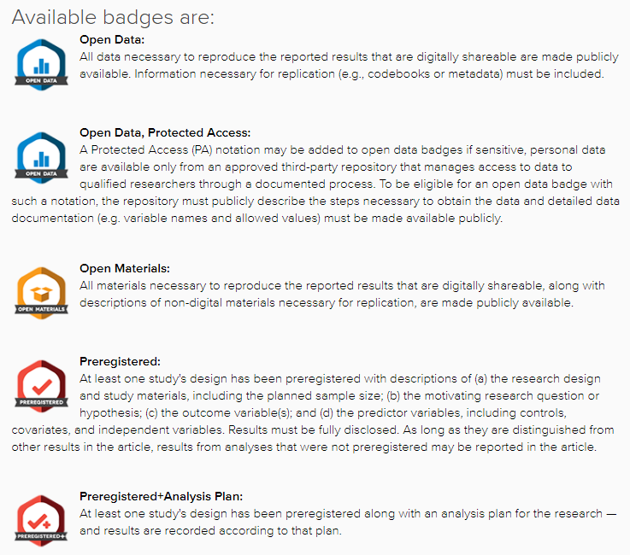
Psychology of Addictive Behaviors
https://www.editorialmanager.com/adb/
Kevin King, PhD, Associate Editor for Open Science

Slide 8
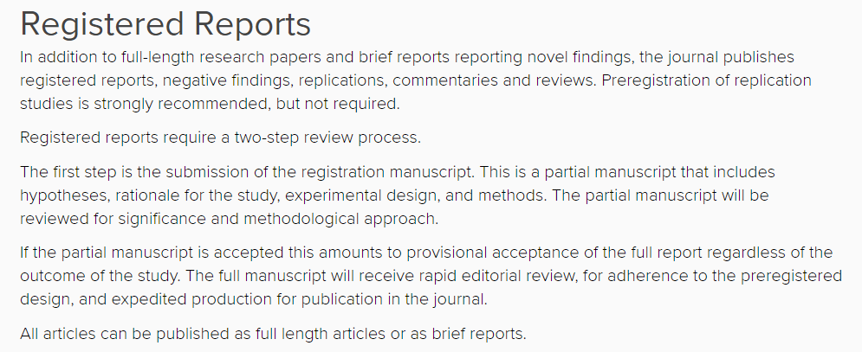
Psychology of Addictive Behaviors
https://www.editorialmanager.com/adb/
Kevin King, PhD, Associate Editor for Open Science

Slide 9
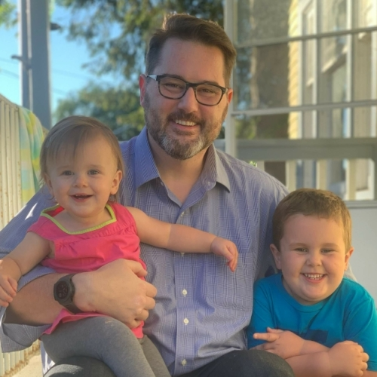
Psychology of Addictive Behaviors
How’s it going?
https://www.editorialmanager.com/adb/
Kevin King, PhD, Associate Editor for Open Science

Slide 10
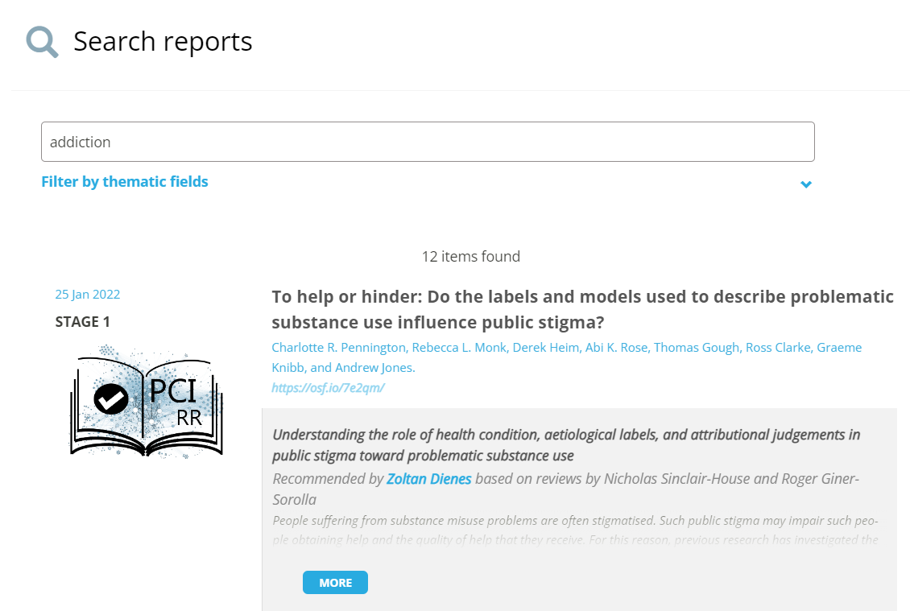
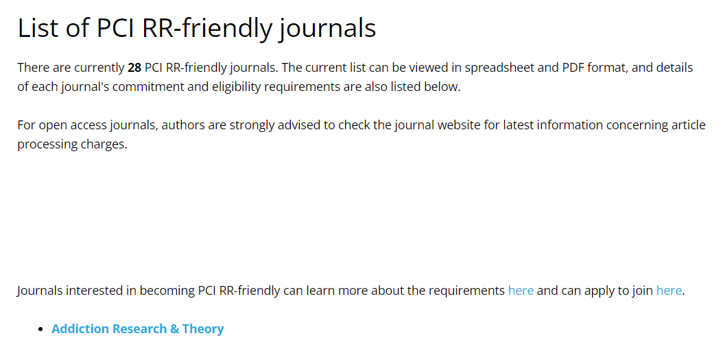
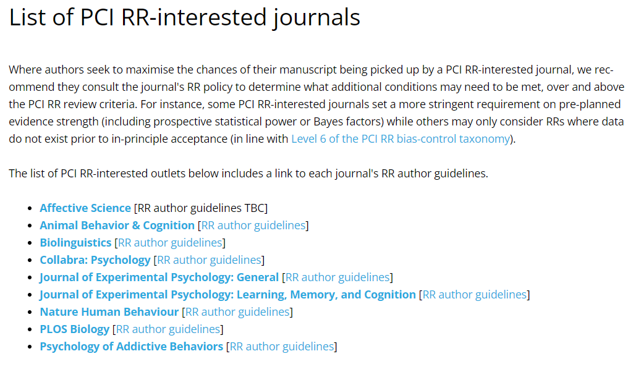
https://rr.peercommunityin.org/

Slide 11
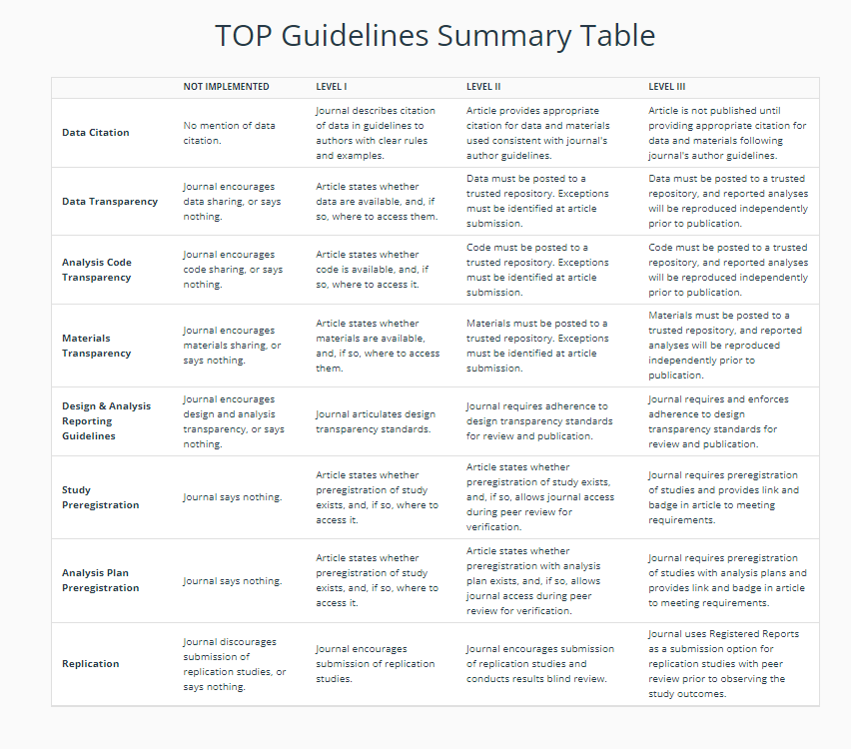
Multiple pathways to become more “open” based on journal and publisher needs and experience
https://topfactor.org/

Slide 12
Kiitos
osf.io
Open resources
Tools/tutorials
Templates

