Slide 1
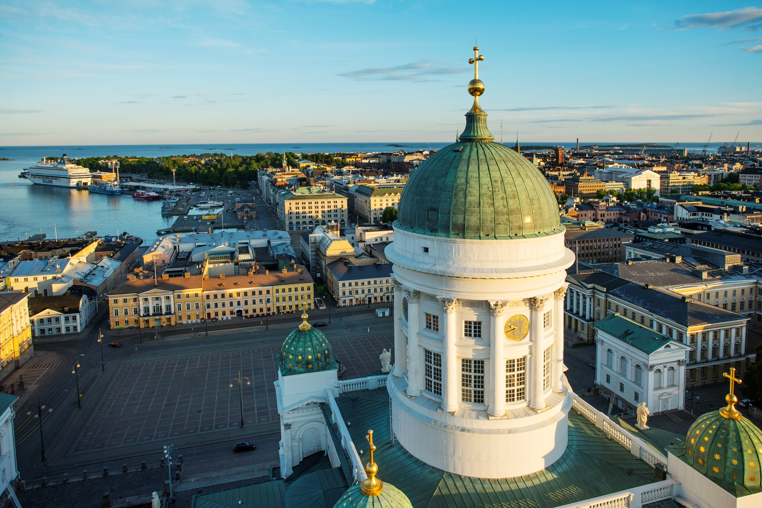
ISAJE meeting
in Helsinki
2-4.9 2020

Slide 2
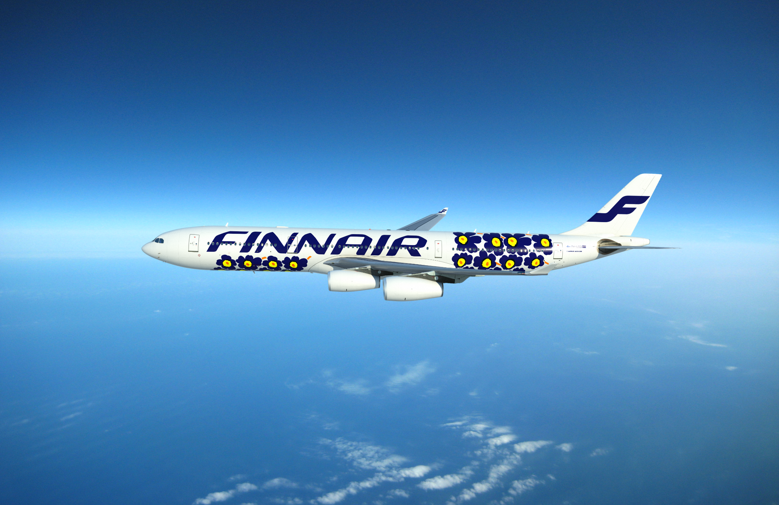
Accessibility
Direct flights from over 140 destinations
60 operating airlines, 180 international arrivals daily
Helsinki Airport located 30 min (20 km) from the city centre with a direct train connection

Slide 3
Everything within walking distance
Free wifi in the city
The most affordable Nordic capital
One of the safest capitals in Europe
Conference
site
Center of Helsinki

Slide 4
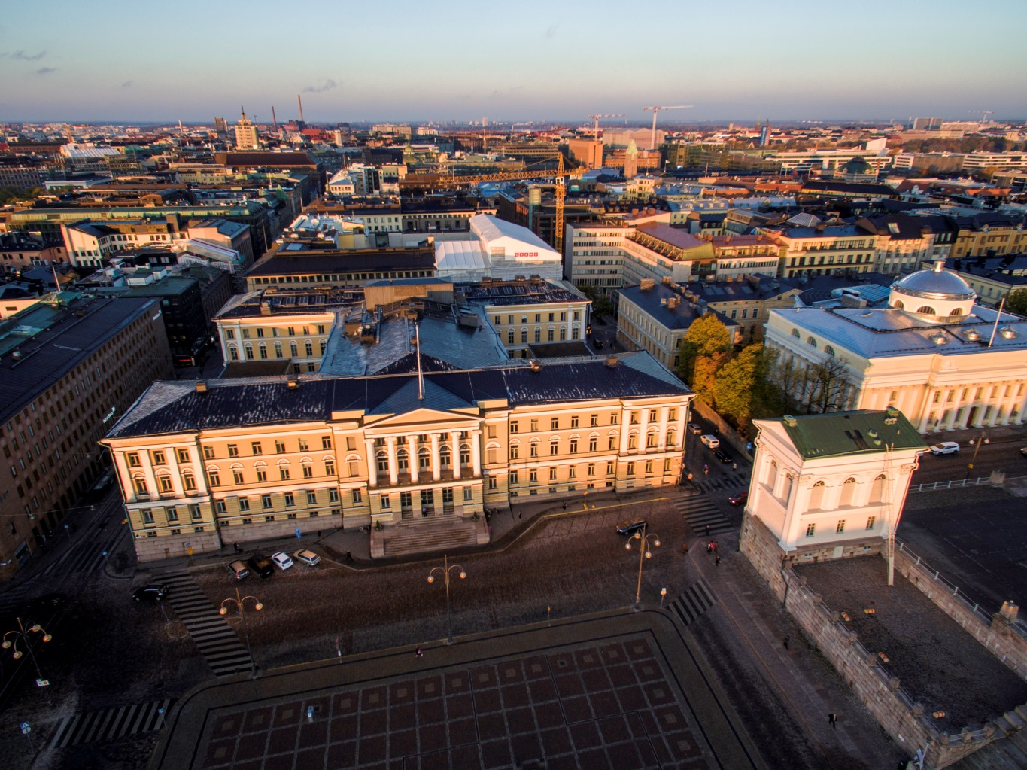
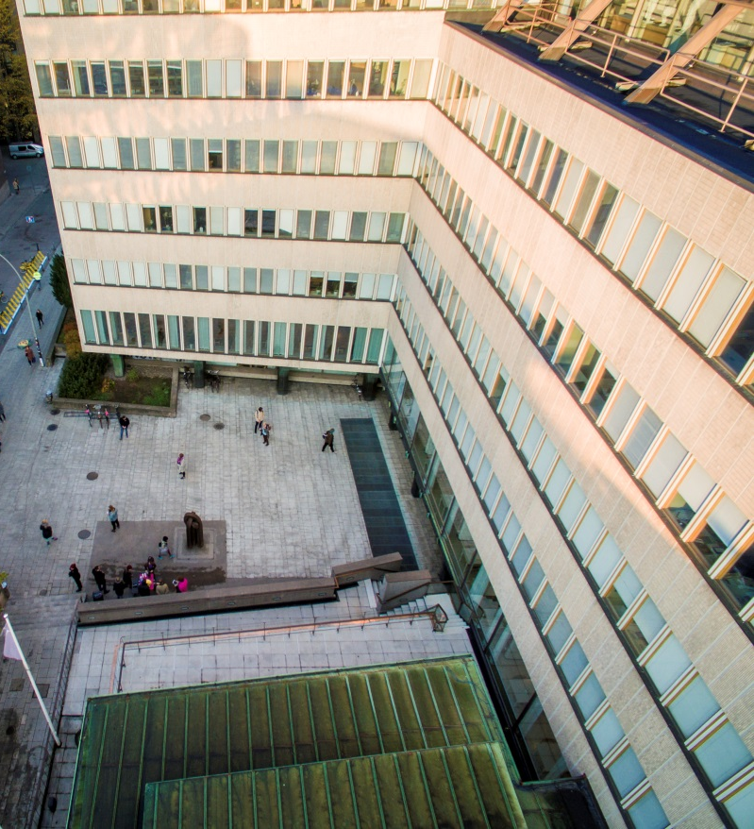
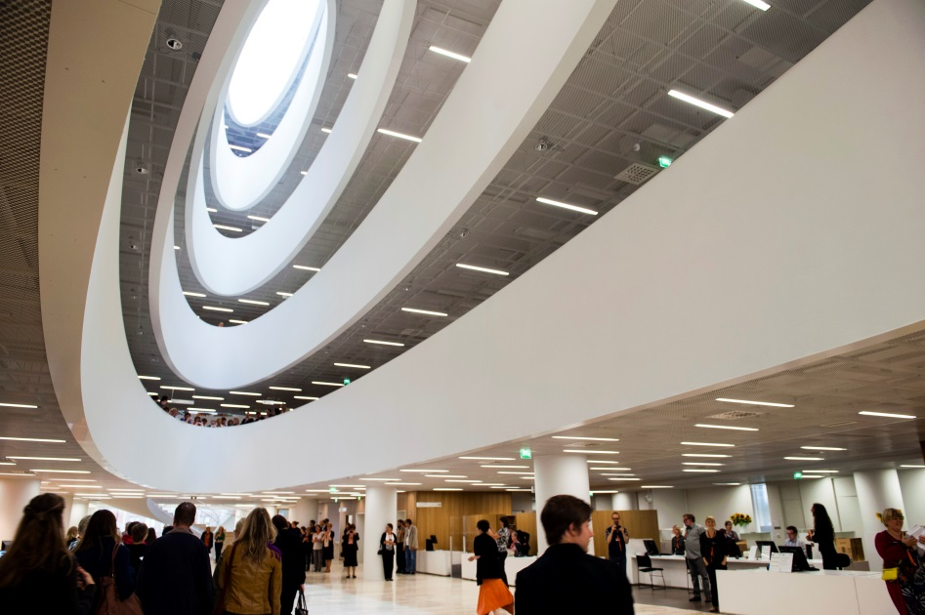
Meeting site: University of Helsinki, in the center of Helsinki

