Slide 1


Rejected but Publishable:
ISAJE Project to Transfer Articles from One Addiction Journal to Another
Adam J. Gordon, MD MPH FACP DFASAM
Editor in Chief – Substance Abuse journal (SAj)
2019 ISAJE (#ISAJE2019 or #ISAJE)
Banff, Canada Sept 5, 2019
Dr. Gordon has no fiduciary or other conflicts to disclose

Slide 2
Genesis: Authors’ Perspectives
Main goal is to get research findings published quickly
Getting research paper published is often a time intensive process
  Submission
  Peer Review
  Editorial Board decisions
Papers often go under several peer review cycles at different journals
Authors often “reach high” to publish their work in the highest quality journal
The peer review process can take time
The peer review/editorial/journal process can be frustrating

Slide 3
Genesis: Editors’ Perspectives
Main goal is to publish high quality work
Obtaining quality peer reviews often takes time
It is unknown how a paper has evolved over time
  Perhaps authors have taken approaches based on prior peer reviews
  Has the article improved?
Soliciting and obtaining external peer reviews takes time
  Perhaps the article has been a thorough and thoughtful review process
  Peer review takes time
The process can be frustrating

Slide 4
Current practice -
When rejecting an article, some Editors offer to:
  Indicate the paper could be accepted in another journal
  Forward the paper to another journal (without reviews)
  Forward the paper to another journal (with reviews)
Transfer of manuscripts:
  Easiest within the publishing house “article is unsuitable”
  “your manuscript may be better suited to one of Taylor & Francis’ other journals, and the Taylor & Francis editorial team might be in touch with some specific suggestions.”
  Easier within the same management system (e.g., ScholarOne)
  Easier with the same formatting requirements
  Easier with author and Editor both being attentive to process

Slide 5
Prior ISAJE proposal:
“Addiction Journal Peer Review Consortium”
An alliance of “addiction” journals that have agreed to accept manuscript reviews from other ISAJE member journals “of the consortium”
Goals:
  Support efficient and thorough peer review of original research
  Reduce delay in possible publication
  Make the process more efficient by saving the scarce resource of reviewers’ time

Slide 6
Prior ISAJE proposal:
“Addiction Journal Peer Review Consortium”
Consortium based on 2008 model of neuroscience journals “The Neuroscience Peer Review Consortium”
  Ongoing alliance of neuroscience journals that have agreed to accept manuscript review from other members of the consortium
    Started in 2008, evaluated in 2011, agreed to continue indefinitely
  Journals may join or leave at any time
Would permit authors whose papers are not accepted for publication by one member journal of the AJC and who wish to submit their manuscript to a second participating journal to request that this previous set of reviews be forwarded to another journal
Advantage:
  Reduce the number of times a manuscript must be reviewed
  Reduce burden on reviewers
  Speed up publication time

Slide 7
SAj Pilot: 2018-2019
Asked authors:
  To forward prior reviews of rejected manuscripts
    In the cover letter
    Reviewers were anonymous
    Could forward ALL the prior reviews (even from multiple journals)
    (no quality control about whether some aspects of the reviews were not forwarded)
  To forward responses to those reviews
    Authors should have responded to those reviews in the cover letter
    Authors should have provided a ”clean copy” and “tracked changes” copy upon submission

Slide 8
SAj Pilot: 2018-2019
Authors uploaded all material in the management system
Editor in Chief decides merits
  Reject or Review
  Inquire to an Associate Editor to review
Associate Editor recommendation:
  Reject
  Send out for SAj external review (normal process)
  Recommend a Revision without external peer review
  Accept

Slide 9
SAj Pilot: 2018-2019
RESULTS
  Several papers (n~12) went through this process
  Several went through either journal peer review or NIH peer review (CTN)
  All were asked to Revise and Resubmit from Associate Editor
    A few were sent out for additional peer review
Seemed simple and painless
Did not require additional burdens for the Editorial Team
Did not require interaction with other journals

Slide 10
ISAJE manuscript sharing proposal, V2
DEFINITIONS
Author:
The manuscript author
Initial journal:
Journal to which the manuscript is originally submitted
Receiving journal:
Journal to which rejected manuscript will be referred
Manuscript eligibility:
This proposal applies to manuscripts that are being rejected after peer review.

Slide 11
ISAJE manuscript sharing proposal, V2
PROCESS:
[Editor/designees]
The manuscript WITH PEER REVIEWS is emailed by the initial journal Editor (or designee) to the Editor (or designee) of the receiving journal
[The author]
  resubmits the article to the receiving journal
  they need not revise the manuscript in accordance with peer reviews or respond to peer review comments
    the reason for this is that the paper will likely need additional review at least by the new Editors who will provide authors with guidance

Slide 12
ISAJE manuscript sharing proposal, V2
NOTES (ISAJE INFORMATION)
Participating journals post the policy in their Instructions for Authors
ISAJE posts the general policy on its website and journals may link to that
ISAJE will maintain an updated list of participating journals
  Editors/publishers can link to that list or check it periodically to update their information
For additional information about other journals or addiction journals in general, they may refer to the Author Resources section of the ISAJE website
  They may also link to Chapter 3.1 in the 3rd edition of Publishing Addiction Science.

Slide 13
ISAJE manuscript sharing proposal, V2
NOTES (INITIAL JOURNAL)
As part of the article submission process the participating initial journal informs authors that they may choose, in the event the paper is rejected, to have the peer reviews sent to a participating journal
Journals inform authors that the process is limited to papers that undergo peer review (instructions for authors or as part of the submission process or both)
Journals may choose to ask author preferences during the submission process (would they like to have the reviews and manuscript forwarded and to which participating journals?)(most efficient) or at the time of rejection via email communication

Slide 14
ISAJE manuscript sharing proposal, V2
NOTES (REVIEWERS)
Reviewer invitations include a note that their reviews may be shared with receiving journals
These reviews will not be anonymous to receiving journal editors because those editors need to know who the reviewers are
Reviewer names, however, will be blinded to authors (and kept so/respected by the receiving journal Editor) unless the reviewer has specifically decided to share their name in their review

Slide 15
ISAJE manuscript sharing proposal, V2
DISADVANTAGES:
This approach does not allow for direct transfer of the manuscript, which currently is generally restricted to within publishers
  to go across publishers would likely mean substantial administrative effort.
This approach also does not relieve authors of the task of re-formatting their paper to meet receiving journal requirements

Slide 16
ISAJE manuscript sharing proposal, V2
ADVANTAGES
This approach
  is minimal effort for all involved
  requires no contracts
  requires no software or sharing platforms
  does not require manuscript submission systems to communicate
  can make it easier to have a quick review from a receiving journal
The main advantage is that peer reviews from known peer reviewers are used by the receiving journal

Slide 17
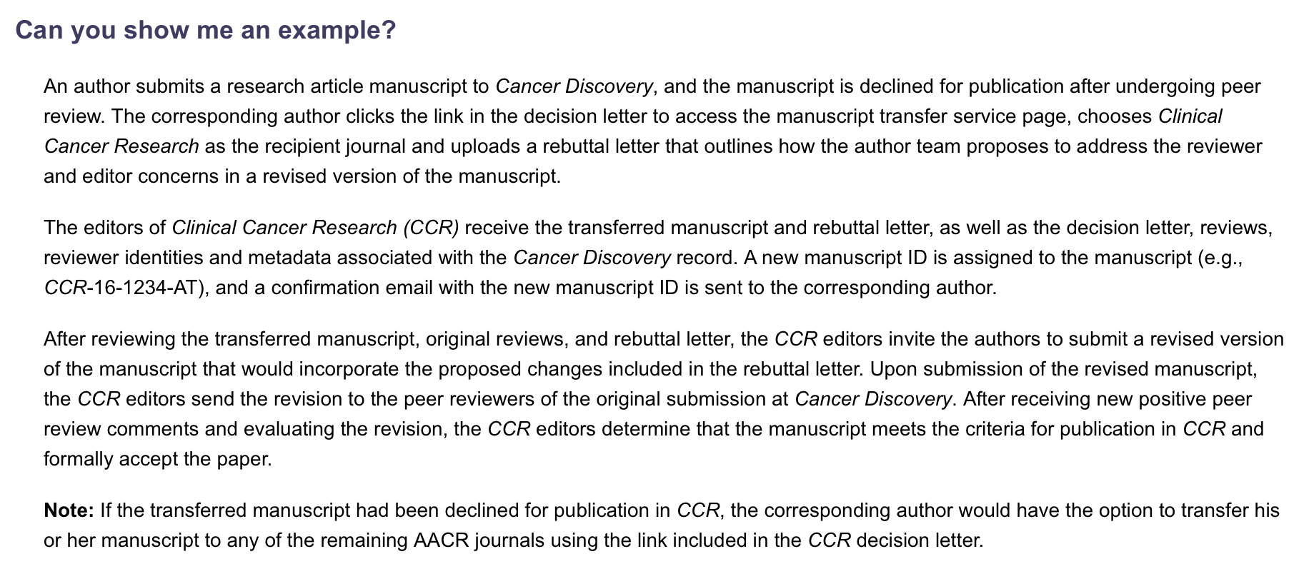
www.aacrjournals.org/content/authors/manuscript-transfer

Slide 18
Proposed next step
Discuss with your publisher
Decide on within publisher vs. outside of publisher transfers
On ISAJE website:
  Compile a list of journal editors/journals who want to participate
  Develop criteria for sending a paper into the referral pool
  Draft a cover letter/text to be addressed to authors
  Description of journals and focus areas
Determine process of authors (resubmit to receiving journal) and editors (submit reviews to receiving journal)
Report back to ISAJE

Slide 19
DISCUSSION

